Slide 1
Binary Search Tree

Slide 2
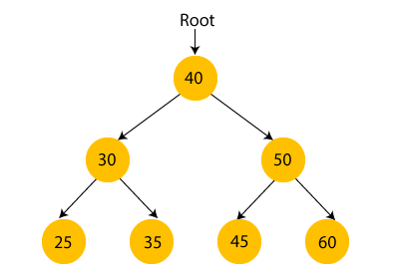
What is a Binary Search tree?
In a Binary search tree, the value of left node must be smaller than the parent node, and the value of right node must be greater than the parent node. This rule is applied recursively to the left and right subtrees of the root.

Slide 3
Advantages of Binary search tree
Searching an element in the Binary search tree is easy as we always have a hint that which subtree has the desired element.
As compared to array and linked lists, insertion and deletion operations are faster in BST.

Slide 4
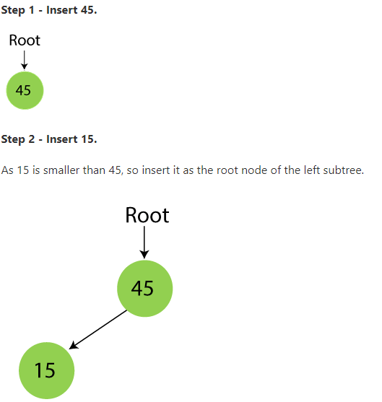
Example of creating a binary search tree
45, 15, 79, 90, 10, 55, 12, 20, 50

Slide 5
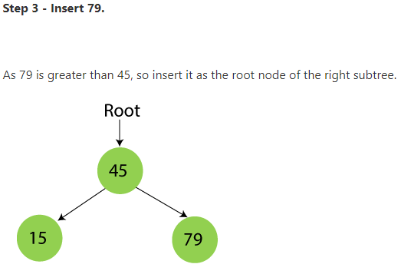

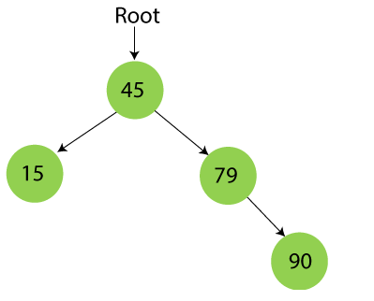
Example of creating a binary search tree

Slide 6
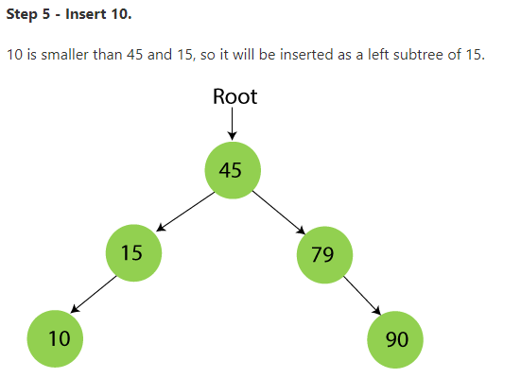
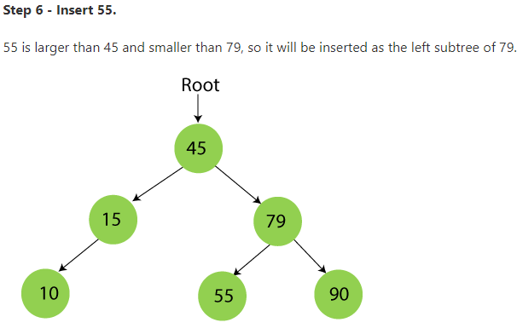
Example of creating a binary search tree

Slide 7
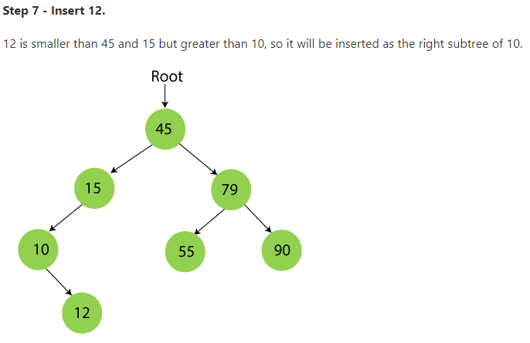
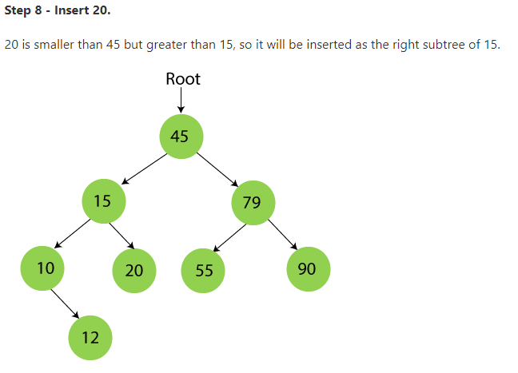
Example of creating a binary search tree

Slide 8
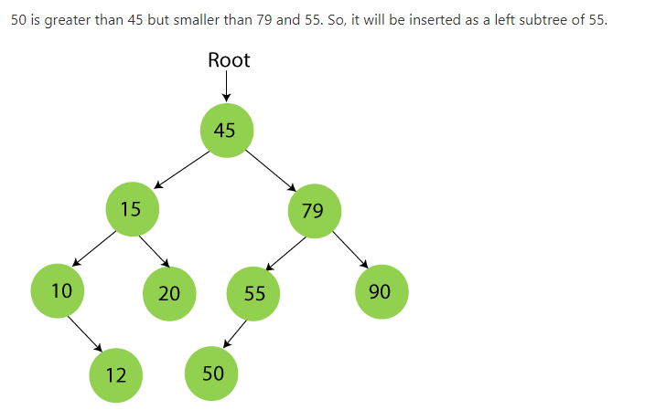
Example of creating a binary search tree

Slide 9
Searching in Binary search tree
Searching means to find or locate a specific element or node in a data structure.
In Binary search tree, searching a node is easy because elements in BST are stored in a specific order.
The steps of searching a node in Binary Search tree are listed as follows –
First, compare the element to be searched with the root element of the tree.
If root is matched with the target element, then return the node's location.
If it is not matched, then check whether the item is less than the root element, if it is smaller than the root element, then move to the left subtree.
If it is larger than the root element, then move to the right subtree.
Repeat the above procedure recursively until the match is found.
If the element is not found or not present in the tree, then return NULL.

Slide 10
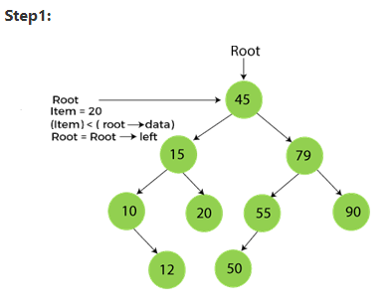
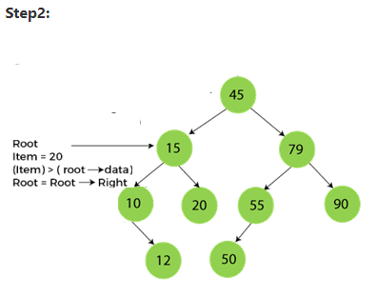
Searching in Binary search tree

Slide 11
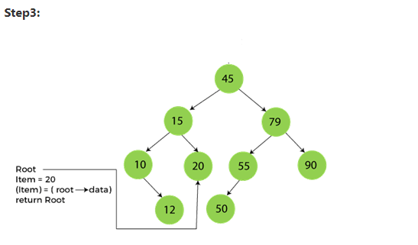
Searching in Binary search tree
Algorithm to search an element
Search (root, item)
Step 1 - if (item = root → data) or (root = NULL)
return root
else if (item < root → data)
return Search(root → left, item)
else
return Search(root → right, item)
END if
Step 2 - END

Slide 12
Deletion in Binary Search tree
In a binary search tree, we must delete a node from the tree by keeping in mind that the property of BST is not violated. To delete a node from BST, there are three possible situations occur -
The node to be deleted is the leaf node, or,
The node to be deleted has only one child, and,
The node to be deleted has two children

Slide 13
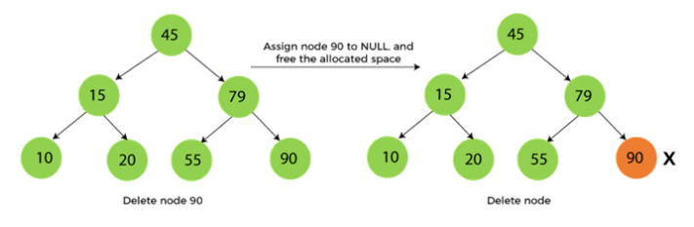
When the node to be deleted is the leaf node
It is the simplest case to delete a node in BST. Here, we have to replace the leaf node with NULL and simply free the allocated space.

Slide 14
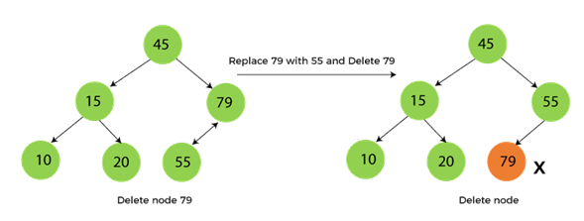
When the node to be deleted has only one child
In this case, we have to replace the target node with its child, and then delete the child node. It means that after replacing the target node with its child node, the child node will now contain the value to be deleted. So, we simply have to replace the child node with NULL and free up the allocated space.

Slide 15
When the node to be deleted has two children
This case of deleting a node in BST is a bit complex among other two cases. In such a case, the steps to be followed are listed as follows -
First, find the inorder successor of the node to be deleted.
After that, replace that node with the inorder successor until the target node is placed at the leaf of tree.
And at last, replace the node with NULL and free up the allocated space.
The inorder successor is required when the right child of the node is not empty. We can obtain the inorder successor by finding the minimum element in the right child of the node.

Slide 16
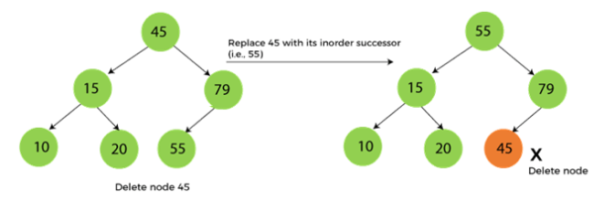
To delete node 45 that is the root node

Slide 17
Insertion in Binary Search tree
A new key in BST is always inserted at the leaf.
To insert an element in BST, we have to start searching from the root node; if the node to be inserted is less than the root node, then search for an empty location in the left subtree.
Else, search for the empty location in the right subtree and insert the data.
Insert in BST is similar to searching, as we always have to maintain the rule that the left subtree is smaller than the root, and right subtree is larger than the root.

Slide 18
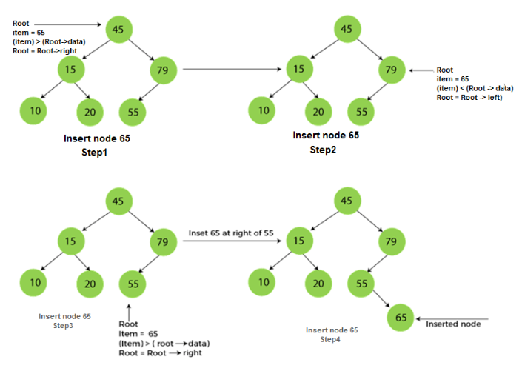
Inserting a node 60 into BST

